Slide 1
Lab3 - MaskGIT for Image Inpainting
2025 Spring
TA 詹雨婷

Slide 2
Submission
If the zip file name or the report spec have format error, you will be punished (-5)
Submission Deadline: 4/1 (Tue) 23:59 p.m.
Turn in: a. Experiment Report (.pdf) b. Source code

Slide 3
Introduction

Slide 4
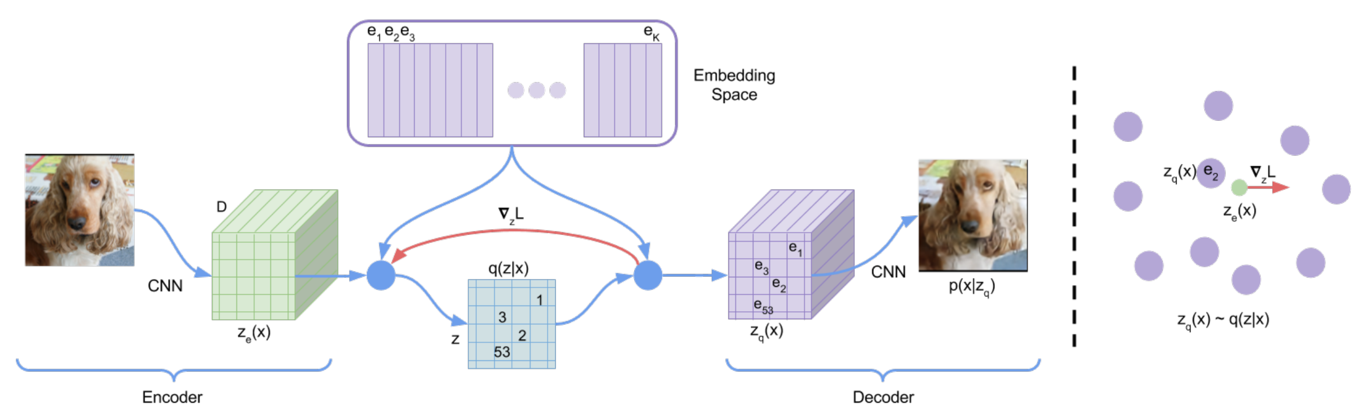
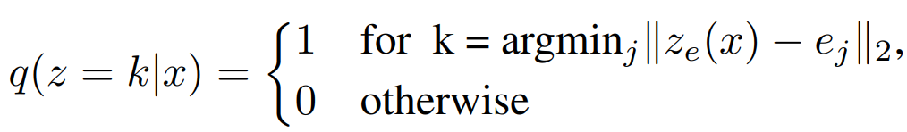
VQ-VAE (prior work)
(codebook)
(token)
Vector quantization: Maps each channel vector in latent space to the nearest codebook entry.

Slide 5
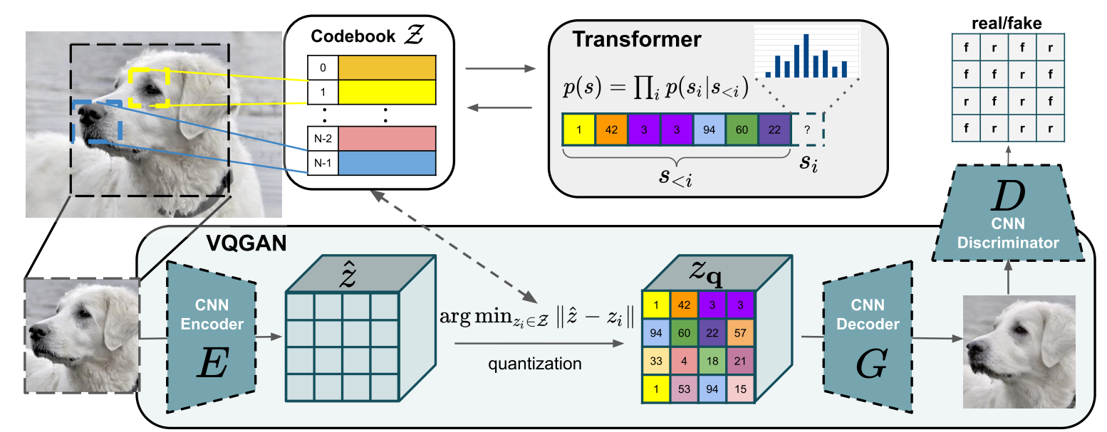
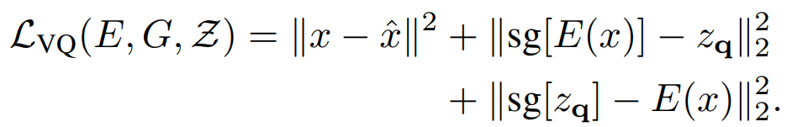
VQ-GAN (prior work)
Perceptual loss replace L2 loss
Adversarial training
Autoregressive Transformer: sequential token generation

Slide 6
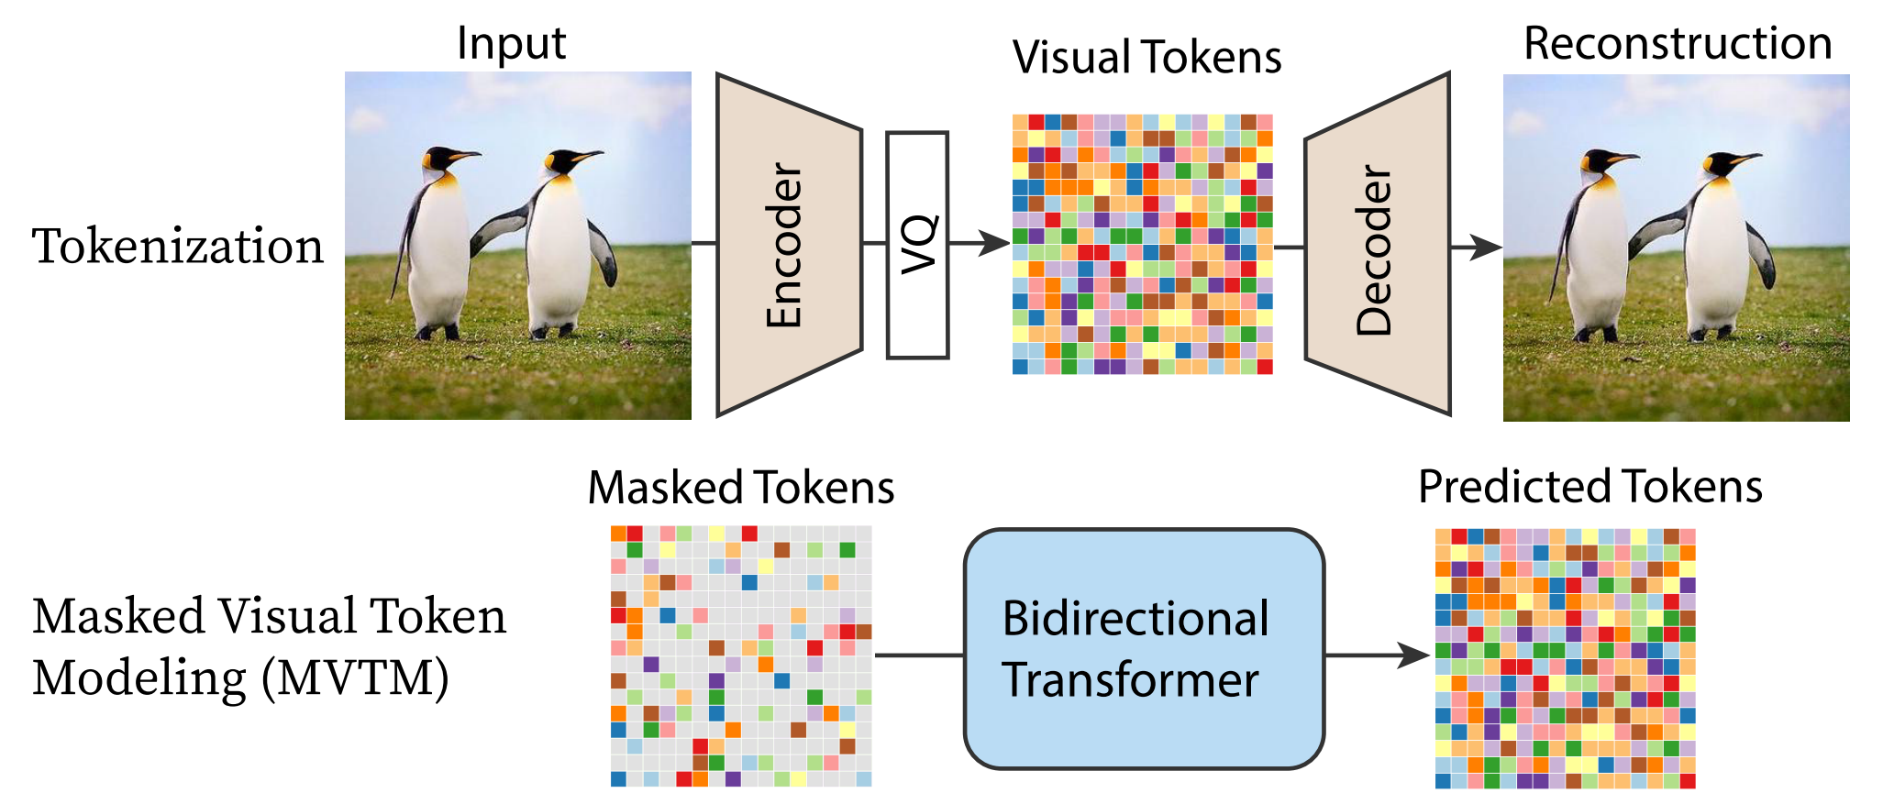
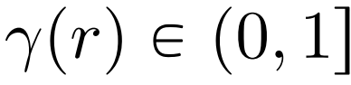
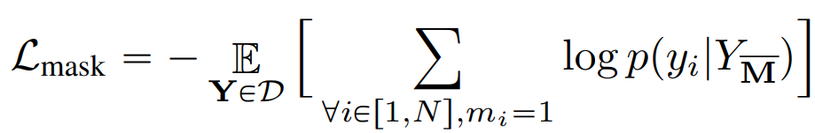
MaskGIT Pipeline Overview
STAGE1
STAGE2
Bidirectional Transformer: parallel token generation
Masked Visual Token Modeling in Training
Mask Ratio:
Cross Entropy Loss:
Notes:
Token embedding 1024+1(mask)->1025,768
Enc consists of multihead attention, mlp
Tokenpredict latent domain ->token domain

Slide 7
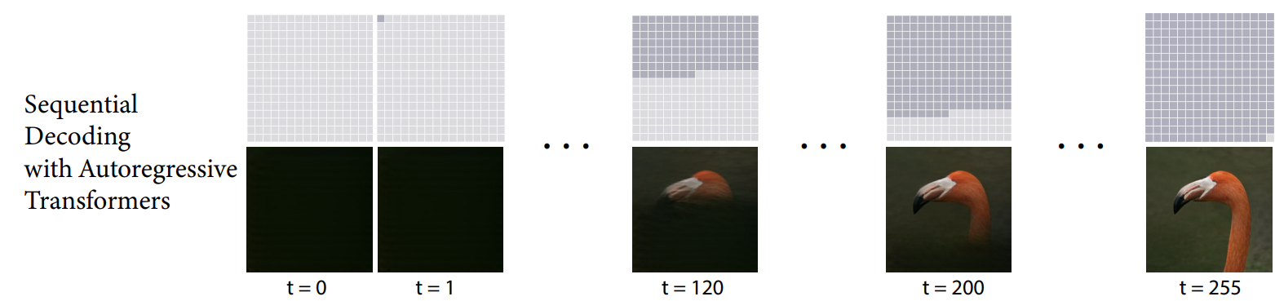
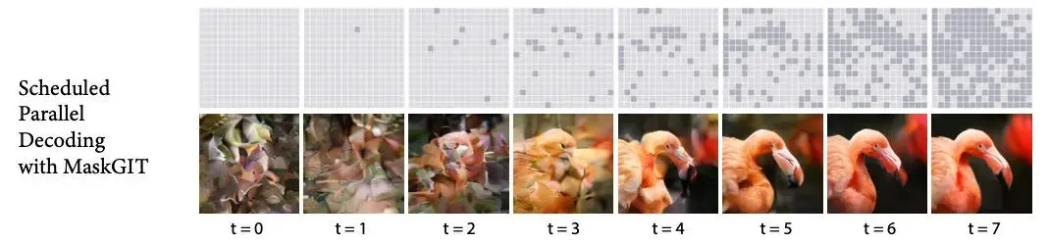
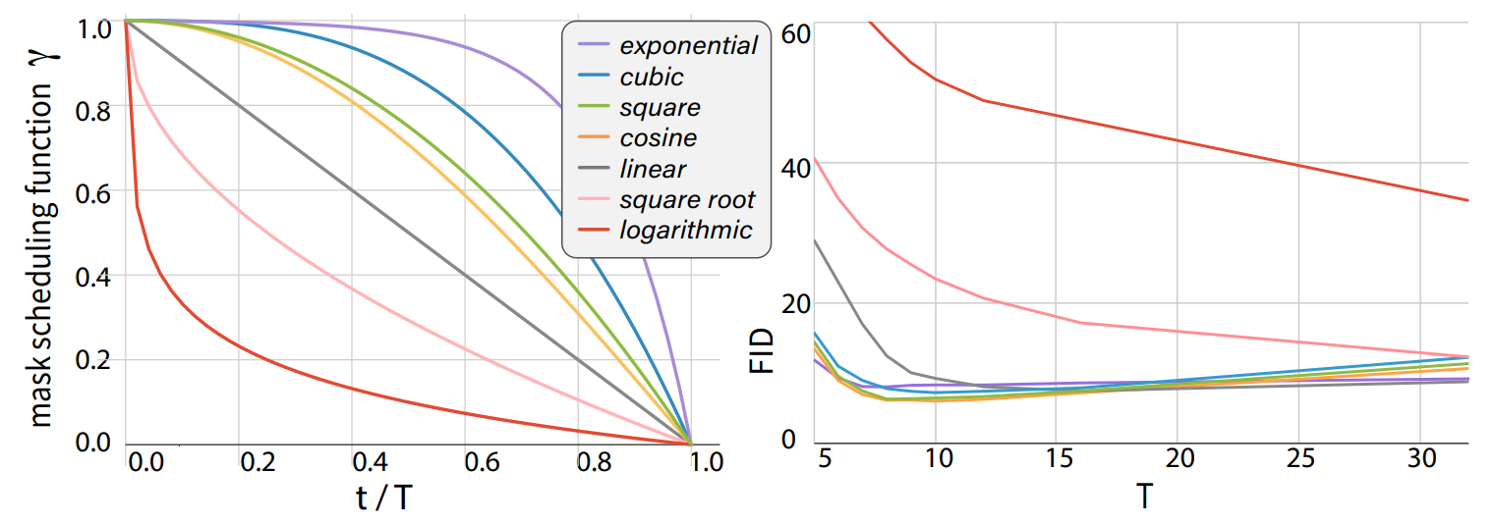

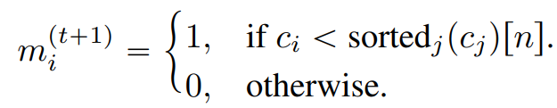
Sequential Decoding v.s Iterative Decoding
VQGAN
MaskGIT
Mask Scheduling Function:
# of Masked tokens in t iteration:
Mask or retain in t+1 iteration:

Slide 8
Lab Details

Slide 9
Lab Objective
Focus on implementing MaskGIT for the inpainting task
During testing, images contain gray regions indicating missing information, which we aim to restore using MaskGIT.
The key practical emphasis of this lab lies in three main areas:
Multi-head attention
Transformer training
Inference inpainting

Slide 10
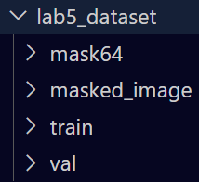
Dataset
a. Training dataset
image: 12000 png files (./lab5_dataset/train)
b. Validation dataset
image: 3000 png files (./lab5_dataset/val)
c. Testing dataset
masked image: 747 png files (./lab5_dataset/masked_image)
mask: 747 png files (./lab5_dataset/mask64 )
Reference: https://www.kaggle.com/datasets/spandan2/cats-faces-64x64-for-generative-models

Slide 11
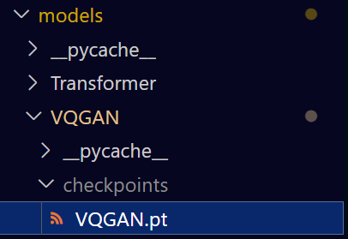
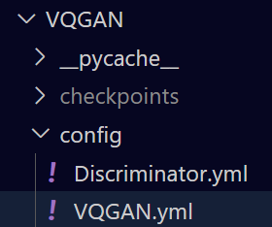
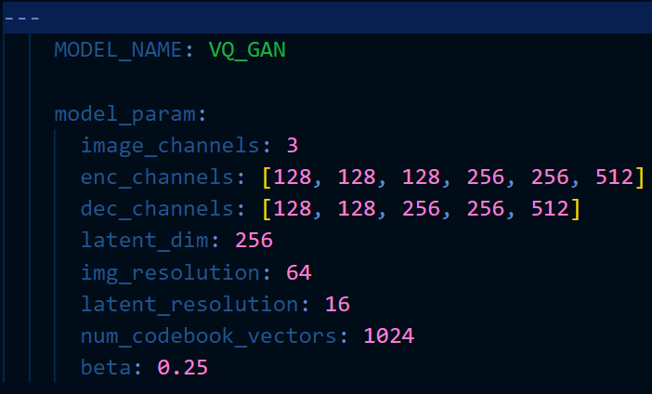
VQGAN Stage1 Pretrained Weight
You can’t modify any model structure or retrain stage1.

Slide 12
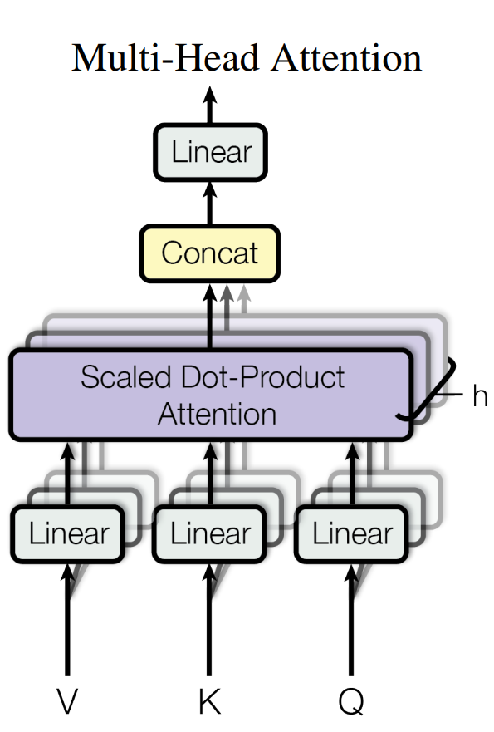
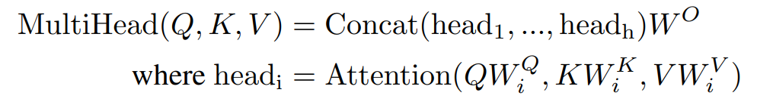
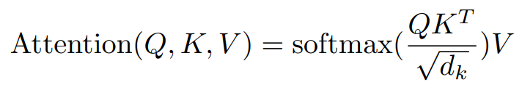
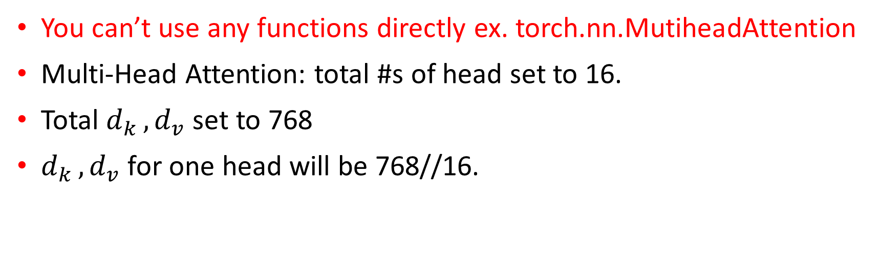
Multi-Head Self-Attention
You can’t use any functions directly ex. torch.nn.MutiheadAttention
Multi-Head Attention: total #s of head set to 16.
Total $d_{k }, d_{v}$ set to 768
$d_{k }, d_{v}$ for one head will be 768//16.

Slide 13

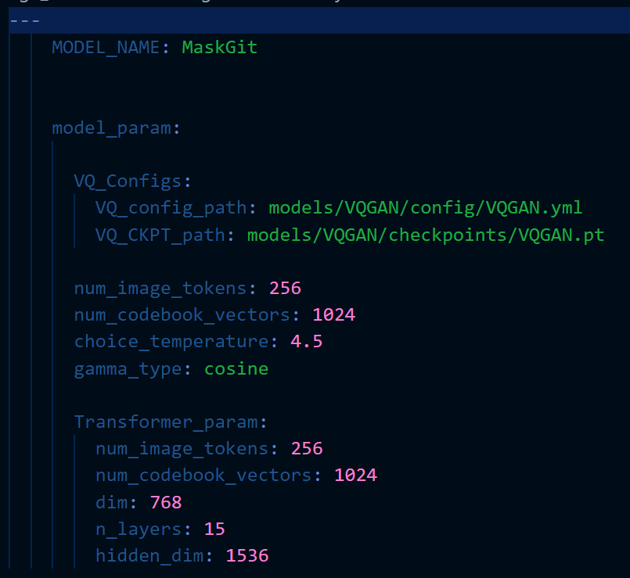
MaskGIT Stage2 Training
You can’t modify any model structure.
Multi-Head Attention: total #s of head set to 16.

Slide 14
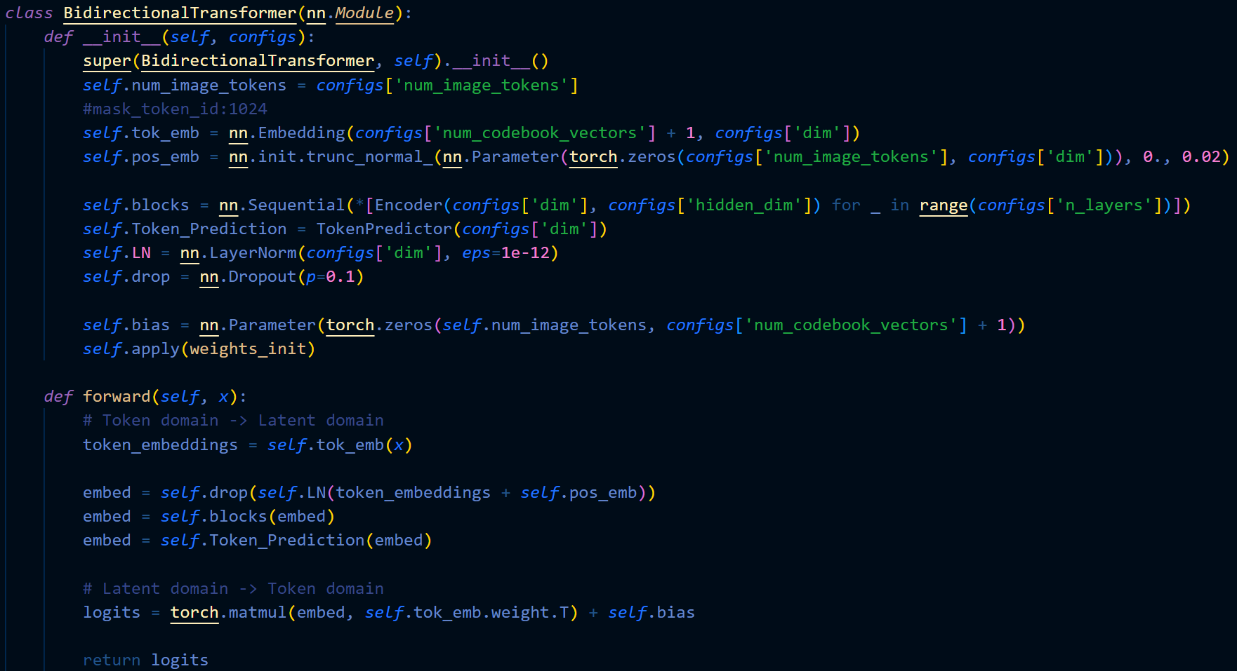
How to set the Masked token?

Slide 15
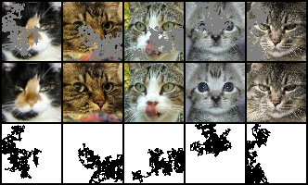
Inference for Image Inpainting Task
Masked image
Binary Mask
Tokenize the masked image
Interpret the inpainting mask as the initial mask in iterative decoding

Slide 16
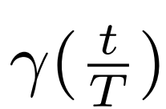
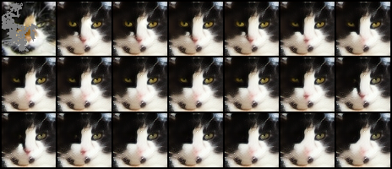
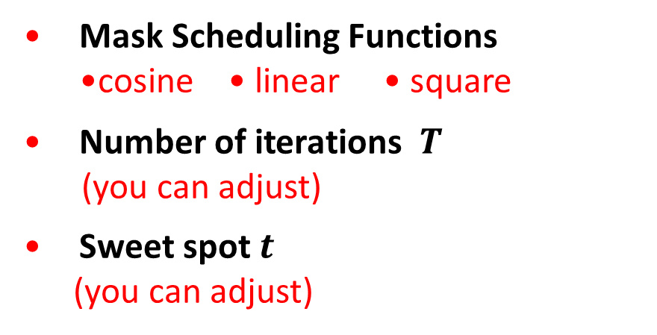
Iterative Decoding
Mask Scheduling Functions •cosine • linear • square
Number of iterations $T$
(you can adjust)
Sweet spot $t$
(you can adjust)

Slide 17
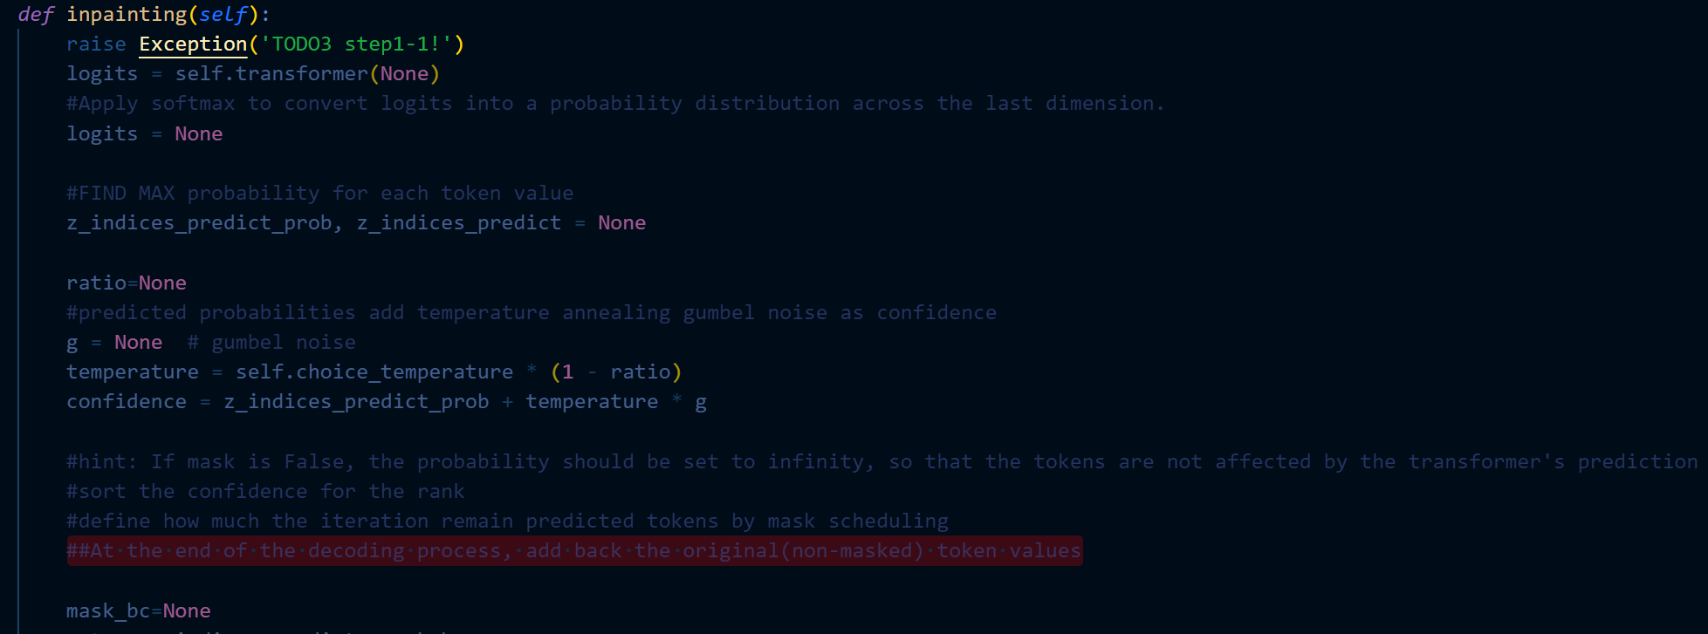
#At the end of the decoding process, add back the original(non-masked) token values
Adding back original pixel domain values is prohibited; doing so results in a score of zero.

Slide 18
Requirements
Download the dataset and pretrained weight of VQGAN (MaskGIT stage1).
Implement the Multi-head attention module on your own, if you use any function directly, your score will -15.
Train your transformer model (MaskGIT stage2) from scratch.
Implement iterative decoding for inpainting task.
Compare the FID score with different settings of mask scheduling parameters and visualize the iterative decoding for mask in latent domain or predicted images.
Notes:
dataset download: https://drive.google.com/file/d/1FTVXBmzyWqtRYWPskNUH3_Lq0vnsC_xO/view?usp=sharing
VQGAN pretrained weight: https://drive.google.com/file/d/1twIeYTRAJcRFU2AZrAQ78PkfA6klwqn5/view?usp=sharing

Slide 19
Report Spec (100%)
1. Introduction (5%)
2. Implementation Details (45%)
A. The details of your model (Multi-Head Self-Attention)
(if you directly call any function, you can’t get any score in this part.)
B. The details of your stage2 training (MVTM, forward, loss)
C. The details of your inference for inpainting task (iterative decoding)
3. Discussion(bonus: 10%)
A. Anything you want to share
4. Experiment Score (50%)

Slide 20

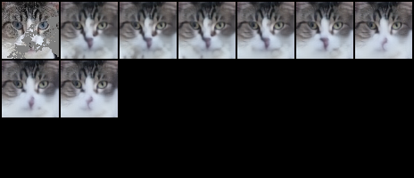
Experiment Score
(Prove your code implementation is correct)
show iterative decoding
Experimental results (30%)
•cosine • linear • square
1.Mask in latent domain
2.Predicted image

Slide 21
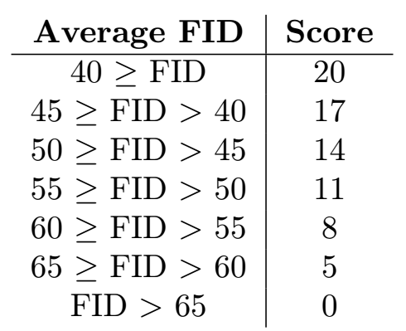
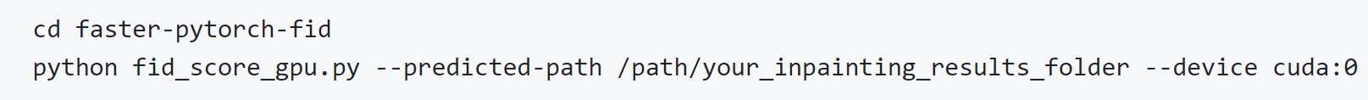
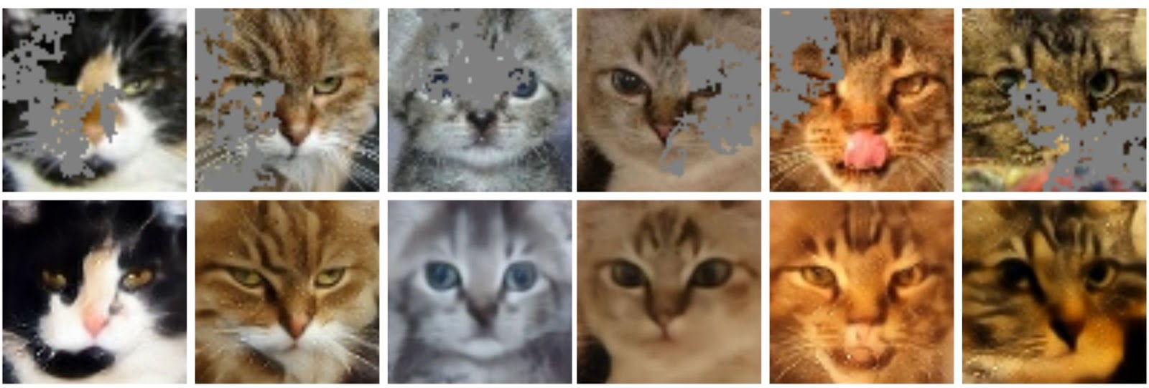
Experiment Score
The Best FID Score(20%)
• Screenshot
• Masked Images v.s MaskGIT Inpainting Results
• The setting about training strategy, mask scheduling parameters, and so on
Masked
Images
MaskGIT Inpainting
Results

Slide 22
References
Ashish Vaswani, Noam Shazeer, Niki Parmar, Jakob Uszkoreit, Llion Jones, Aidan N. Gomez, Lukasz Kaiser, and Illia Polosukhin. Attention is all you need. In NeurIPS, 2017. https://arxiv.org/pdf/2202.04200.pdf
A. van den Oord, O. Vinyals, et al., “Neural discrete representation learning,” in Advances in Neural Information Processing Systems, pp. 6306–6315, 2017. https://arxiv.org/abs/1711.00937
Esser, P., Rombach, R., and Ommer, B.: Taming Transformers for High-Resolution Image Synthesis. In: Proceedings of the IEEE/CVF Conference on Computer Vision and Pattern Recognition, pp. 12873–12883 (2021) https://arxiv.org/abs/2012.09841
Huiwen Chang, Han Zhang, Lu Jiang, Ce Liu, and William T. Freeman. Maskgit: Masked generative image transformer. In: Proceedings of the IEEE/CVF Conference on Computer Vision and Pattern Recognition, June 2022. https://arxiv.org/abs/2202.04200

